Slide 1

Introduction to GitHub

Slide 2
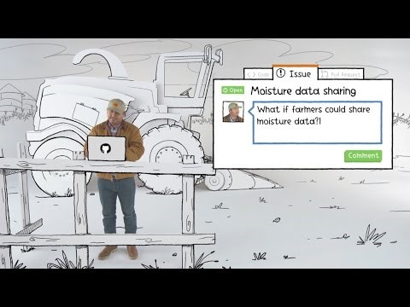
What is GitHub?

Slide 3
GitHub and Git
Git is a revision control system, a tool to manage your source code history.
GitHub is a hosting service for Git repositories.
Git is the tool, GitHub is the service for projects that use Git.

Slide 4
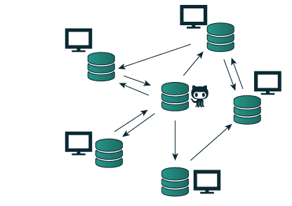
How will we use GitHub?
Instructors will provide learning and practice materials in a GitHub Repository
Students may copy that material through a Fork
Students will create a local Clone of their GitHub repository
Students will store their work in GitHub
Students may collaborate using GitHub

Slide 5
Basic GitHub Terms
Repository – like a folder for a project. Contains all of the project files and stores each file’s revision history
Fork – A copy of a repository that you manage. Lets you make changes to a project without affecting the original repository
Clone - A copy of a repository that lives on your computer instead of on a website's server somewhere

Slide 6
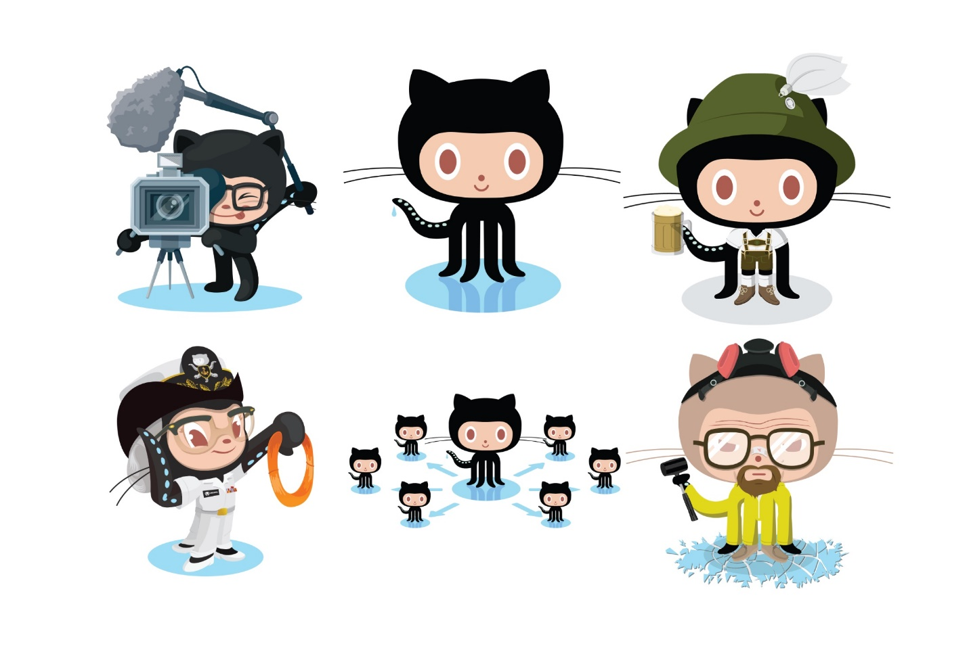
Practice
Follow the instructions to fork/create and clone a repository!

Slide 7
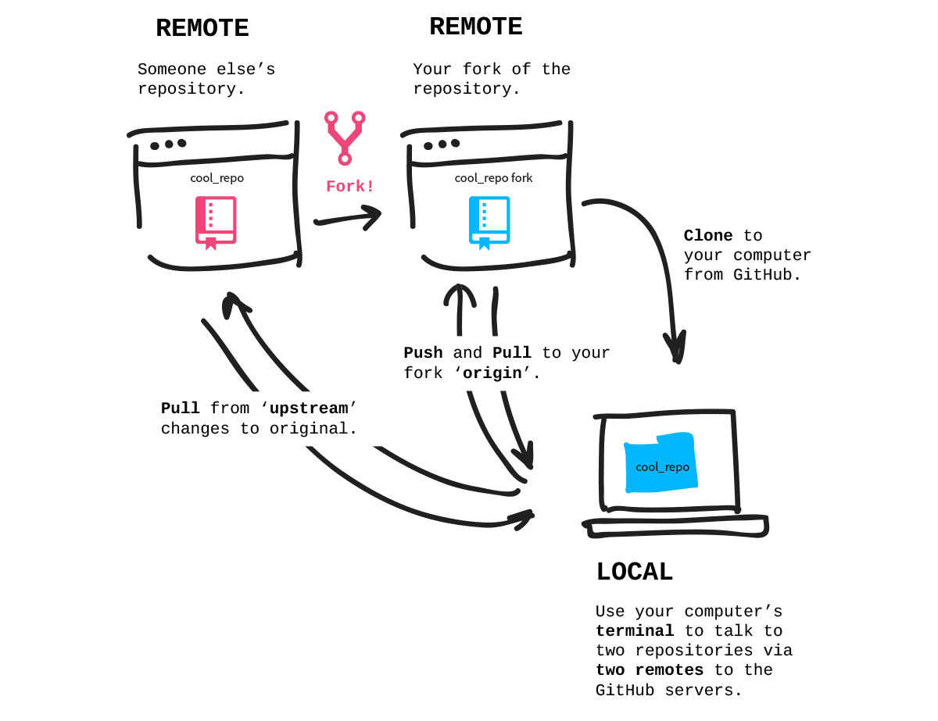
Pushing and Pulling

Slide 8
More GitHub Terms
Commit – An individual change to a file or set of files. Similar to saving files, but with record keeping
Push – To send your committed changes to a remote repository, such as a repository on GitHub
Pull – To fetch changes from a repository and merge them into your local copy

Slide 9
git add && git commit && git push
When you want to store an update to your repository, you have to add the change, commit the change, and push the change.
Make a change in your local repository (clone)
Add the change to your staged changes
Commit the changes to your local repository
Push the changes to your server repository

Slide 10
git pull
When you want to update your local files with the latest version of your server repository, or you’re working from a fork and want to merge in changes from the original repository (called the upstream), you have to pull the changes.
You can:
Pull from your server repository
Pull from the original repository (upstream)
If you pull from the original repository, you will also have to commit/push those changes up to your fork

Slide 11
Practice
Follow the instructions to push and pull some changes!

